Slide 1
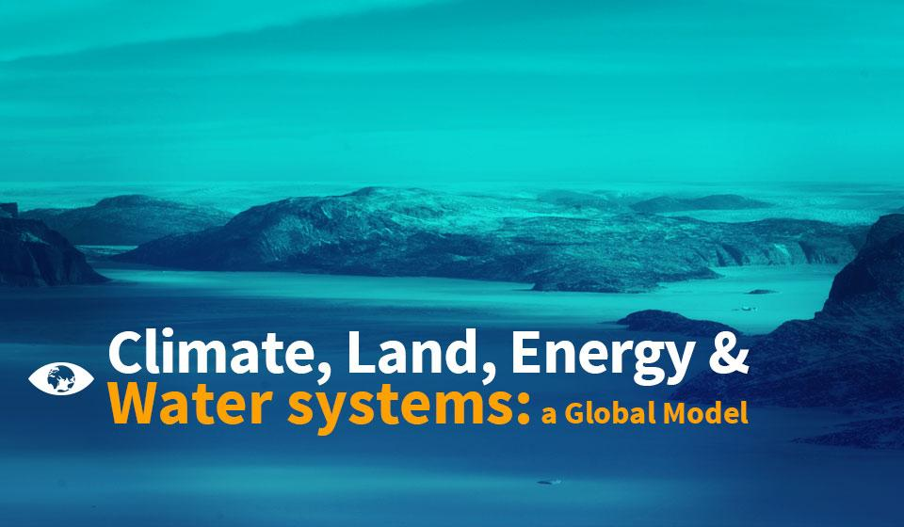

Slide 2
An integrated assessment model: the global CLEWS
Basic idea: land, energy and water systems are highly integrated, and any assessment of these resources should ideally treat them as such.
Allows for integrated assessment of the food-energy-water nexus.
Enables evaluation of the general robustness of a particular strategy or policy with respect to risks of climate change.
Land
Energy
Water
Climate
Climate

Slide 3
The global CLEWS online demonstration tool
The visualization tool presents the results of the global CLEWS model to demonstrate the interlinkages among climate, land use, water and energy.
It includes four scenarios:
Policies in countries correspond to pre-Paris Agreement nationally determined contributions and lead to an increase in temperature of between 4 degrees and 6 degrees Celsius.
Policies constrain the use of carbon fuels in energy, industry and agriculture to avoid increases in temperature larger than 4 degrees Celsius.
Policies constrain the use of carbon fuels in energy, industry and agriculture to avoid increases in temperature larger than 2 degrees Celsius.
Policies do NOT directly constrain the use of carbon but introduce a carbon tax that progressively increases in significance.

Slide 4
Interlinkages in the global CLEWS model
Primary energy sources are extracted, supplied or transformed into secondary energy carriers.
Final energy is used by households, industry and agriculture to satisfy energy services.
Land (agriculture) uses energy and water for irrigation and fertilizers to meet global food and biomass demand.
Industries use energy and materials to meet global demand for materials.
Carbon-based fuels for energy, land and materials sectors emit carbon dioxide.
The world demands food, energy and materials.
Examples of primary energy sources: coal, gas, oil, wind, nuclear, hydro, geothermal, biomass, etc.
Examples of energy services: heat, motion, light, etc.
Examples of materials produced: cement, aluminum, fertilizers, steel, paper and pulp, petrochemicals, etc.

Slide 5
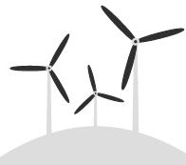
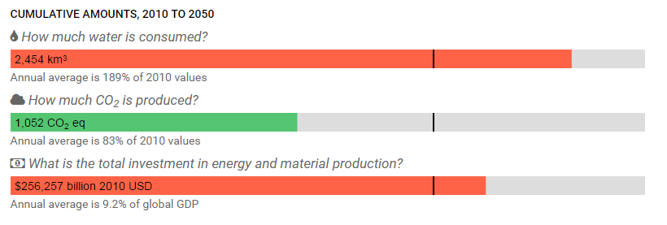
Trade-offs: 2 degrees scenario
Illustrative cases of trade-offs the model can shed light upon:
How is water consumption changed across scenarios?
How do CO₂ emissions increase or decrease across scenarios?
How does total investment in energy generation and material production vary across scenarios?
A desirable outcome in one area may have an undesirable effect in another.
baseline

Slide 6
Emissions and water use
How does the model estimate the impact of each scenario on CO₂ emissions and water use?
Water is used in the extraction and production of coal, oil and gas as well as in the transformation of energy sources such as hydro, nuclear and biomass.
CO₂ emissions result from the use of carbon fuels to generate energy for households, agriculture and industries.
Scenarios impose different constraints on the use of carbon fuels or incorporate a tax that creates incentives for replacing the use of carbon fuels with other forms of energy sources.
Use of different mixes of fuels results in different estimates of CO₂ emissions and water use.

Slide 7
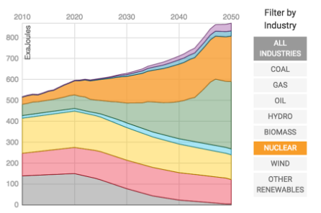
Energy supply
How are energy supply and renewable use affected in each scenario?
Scenarios impose limits on fossil fuel use and/or apply a carbon tax that result in a different mix of fuels and energy technologies necessary to meet the global demand for food and materials.
For example: To achieve the 2 degrees scenario, renewable energy sources must increase sixfold by 2050, including significant investments in biomass and nuclear energy.

Slide 8
Highlights
The differences between the 4 degrees scenario and baseline scenario are small. Changes in total primary energy supply are visible post-2030, when the contribution of coal and gas is slightly lower and complemented by nuclear and biomass.
To limit emissions below 2 degrees without any compromises on the demand side, the energy supply needs to be completely restructured. Nuclear power and biofuels are part of the least-cost solution to achieve this. Coal use diminishes, while gas and oil retain a significant share of the energy supply.
Emissions in the carbon tax and 4 degrees scenarios are almost identical, which means that even with a conservative tax the investment portfolios can easily be directed towards cleaner technologies.

Slide 9
Modelling tools for sustainable development
Form groups of three or four with a computer.
Go to:
https://unite.un.org/sites/unite.un.org/files/app-globalclews-v-1-0/landingpage.html.

Slide 10
Using the global CLEWS online tool
To analyse interlinkages directly, compare “side-by-side” across scenarios (use dropdown menu).
Global estimates of CO₂ emissions, water use, and investment in energy and material production
Bar charts indicate the use, emissions or investment under each scenario in absolute differences relative to 2010 values.
Green bars indicate levels are below the 2010 base, yellow if equal and red if above.
Estimates of CO₂ emissions and water use by energy source
Stacked line charts are used to shows the estimated levels of emissions and water use by energy fuels and technologies.
Users can look at a single energy source by clicking on the list on the side.
Hovering the mouse over the graphs shows estimated values.
Estimates of mix of energy supply
Stacked line charts show the energy mix for each scenario.
Users can look at a single energy by clicking on the graph.

Slide 11
Exercises
Explore the results for the baseline scenario.
Develop a brief narrative of the main developments.
Explore the results of the 2 degree scenario
Develop a brief narrative explaining how the 2 degree target is met (i.e., what are the changes from the baseline?).
What are the trade-offs with other policy goals (i.e., what is the “price” we have to pay for the carbon reductions)?
Are these trade-offs inevitable or can they be addressed through policy?
Think of a couple of weaknesses of this analysis or questions left unanswered.
What additional analytic work (e.g., scenarios) would you recommend to remedy this?

